Slide 1

Chapter 14
Simulation, Graphics, and Other Applications

Slide 2
Chapter Goals (1 of 3)
Define simulation
Give examples of complex systems
Distinguish between continuous and discrete event simulation
Explain how object-oriented design principles can be used in building models

Slide 3
Chapter Goals (2 of 3)
Name and discuss the four parts of a queuing system
Explain the complexity of weather and seismic models
Describe the important issues in graphics image generation

Slide 4
Chapter Goals (3 of 3)
Explain the additional concerns for animation versus single images
Describe the important issues in computer gaming

Slide 5
What Is Simulation?
Simulation
A model of a complex system and the experimental manipulation of the model to observe the results
Systems that are best suited to being simulated are dynamic, interactive, and complicated
Model
An abstraction of a real system
It is a representation of the objects within the system and the rules that govern the interactions of the objects

Slide 6
Constructing Models (1 of 2)
Continuous Simulation
Treats time as continuous
Expresses changes in terms of a set of differential equations that reflect the relationships among the set of characteristics
Meteorological models fall into this category

Slide 7
Constructing Models (2 of 2)
Discrete Event Simulation
Made up of entities, attributes, and events
Entity The representation of some object in the real system that must be explicitly defined
Attribute Some characteristic of a particular entity
Event An interaction between entities

Slide 8
Queuing Systems (1 of 4)
Queuing System
A discrete-event model that uses random numbers to represent the arrival and duration of events
The system is made up of
Servers
Queues of objects to be served
Please
wait!

Slide 9
Queuing Systems (2 of 4)
Can you name at least three queuing systems that you interact with every day?

Slide 10
Queuing Systems (3 of 4)
To construct a queuing model, we must know:
The number of events and how they affect the system in order to determine the rules of entity interaction
The number of servers
The distribution of arrival times in order to determine if an entity enters the system
The expected service time in order to determine the duration of an event

Slide 11
Queuing Systems (4 of 4)
Given a hypothetical service station, what are:
The events?
The number of servers?
How can you determine:
Distribution of arrival time?
Expected service time?

Slide 12
Meteorological Models (1 of 4)
Meteorological Models
Models based on the time-dependent partial differential equations of fluid mechanics and thermodynamics
Initial values for the variables are entered from observation, and the equations are solved to define the values of the variables at some later time

Slide 13
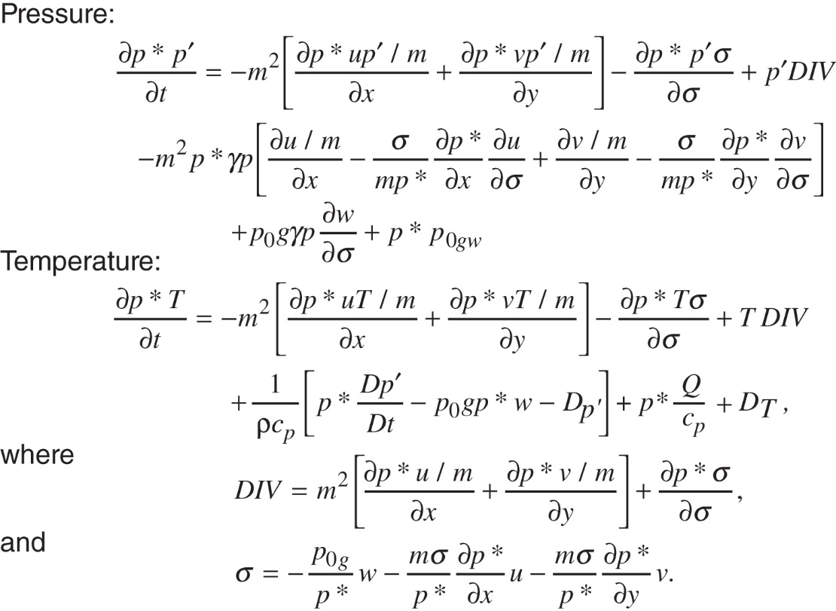
Meteorological Models (2 of 4)
How much
math
does it
take to
be a
meteorologist?
Some of the complex equations used in meteorological models

Slide 14
Meteorological Models (3 of 4)
Computer models are designed to aid the weathercaster, not replace him or her.
The outputs from the computer models are predictions of the values of variables in the future
It is up to the weathercaster to determine what the values mean

Slide 15
Meteorological Models (4 of 4)
Relocatable Models
Models applied to a moving target
Can you think of an example?
What is special about weather models?

Slide 16
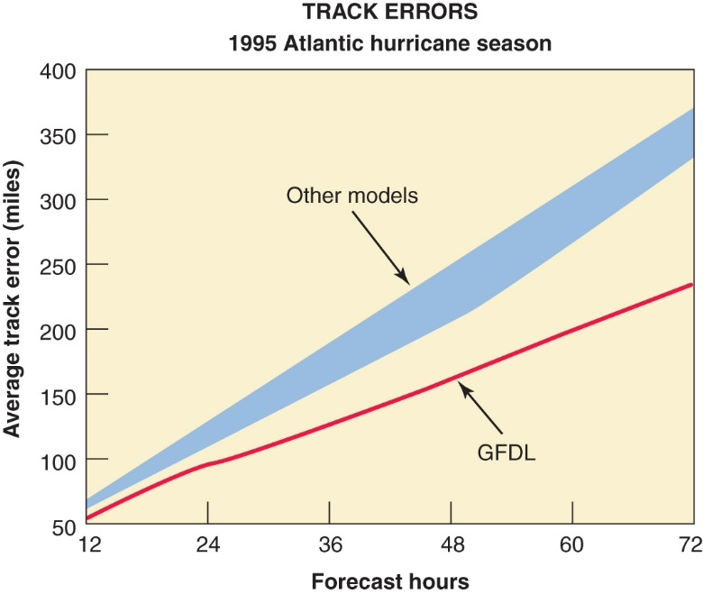
Hurricane Tracking
(GFDL)
Geophysical
and Fluid
Dynamics
Laboratory
Improvements in hurricane models
Reprinted, by permission, from the National Science and Technology Council, High Performance Computing and Communications: Advancing the Frontiers of Information Technology

Slide 17
Computational Biology
An interdisciplinary field that applies techniques of computer science, applied mathematics, and statistics to problems in biology
Encompasses bioinformatics, computational biomodeling, computational genomics, molecular modeling, and protein structure prediction
Can you think of some recent successes?
17
Notes:
17

Slide 18
Graphics (1 of 5)
Graphics
Originally the language of communications for engineers, designers, and architects
Computer-Aided Design (CAD)
A system that uses computers with advanced graphics hardware and software to create precision drawings or technical illustrations
What does the term encompass today?

Slide 19
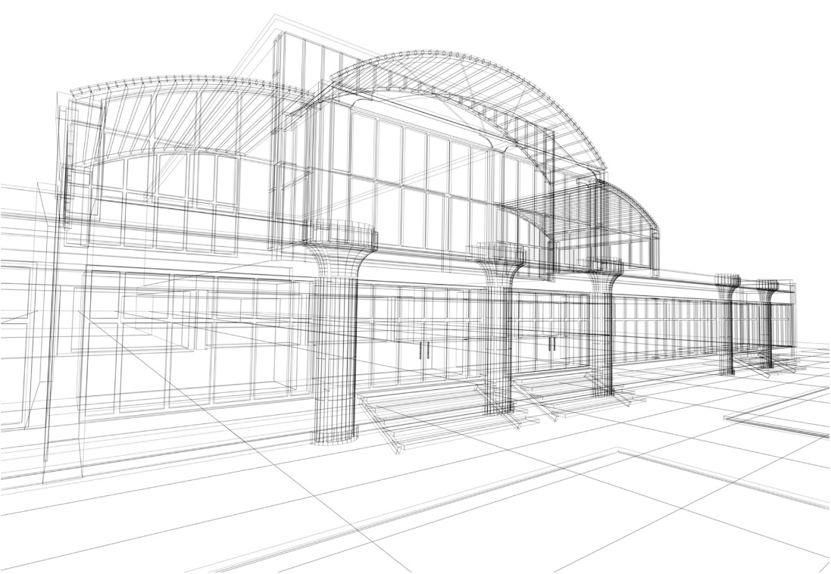
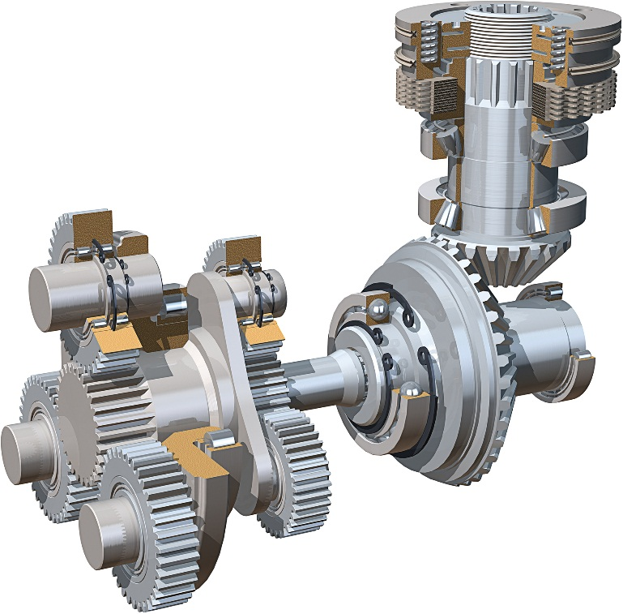
Graphics (2 of 5)
© Stephen Sweet/Shutterstock
© ArtyFree/Shutterstock
Geometric modeling techniques

Slide 20
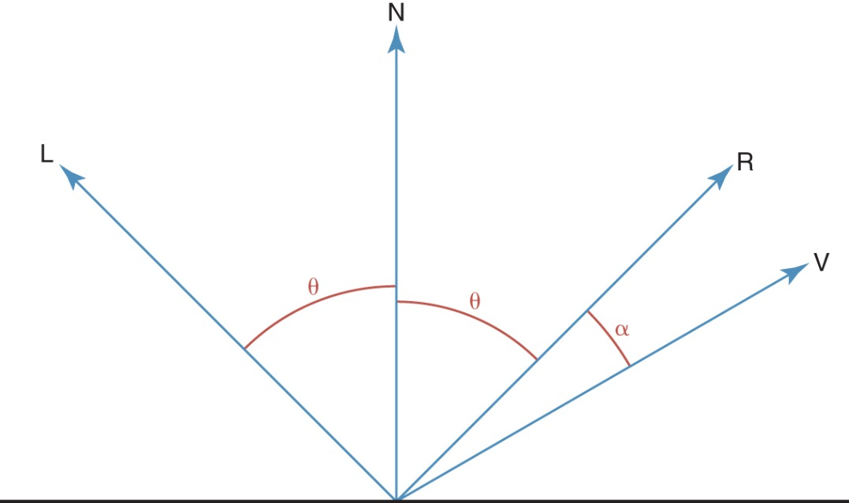
Graphics (3 of 5)
How does light work?
The normal (N), light (L), view (V), and reflection (R) vectors

Slide 21
Graphics (4 of 5)
Shape and surface influence an object’s
appearance
Equations used to describe planes, spheres,
and cylinders
Real world surfaces are rough, which scatter
light differently, requiring texture mapping
techniques

Slide 22
Graphics (5 of 5)
Illumination Model
Simulation of light interaction at one point
on an object
Shading Model (shading)
Process of using an illumination model
to determine the appearance of an
entire object
Rendering
The process of creating an entire image
What
is the
problem
with this
model?

Slide 23
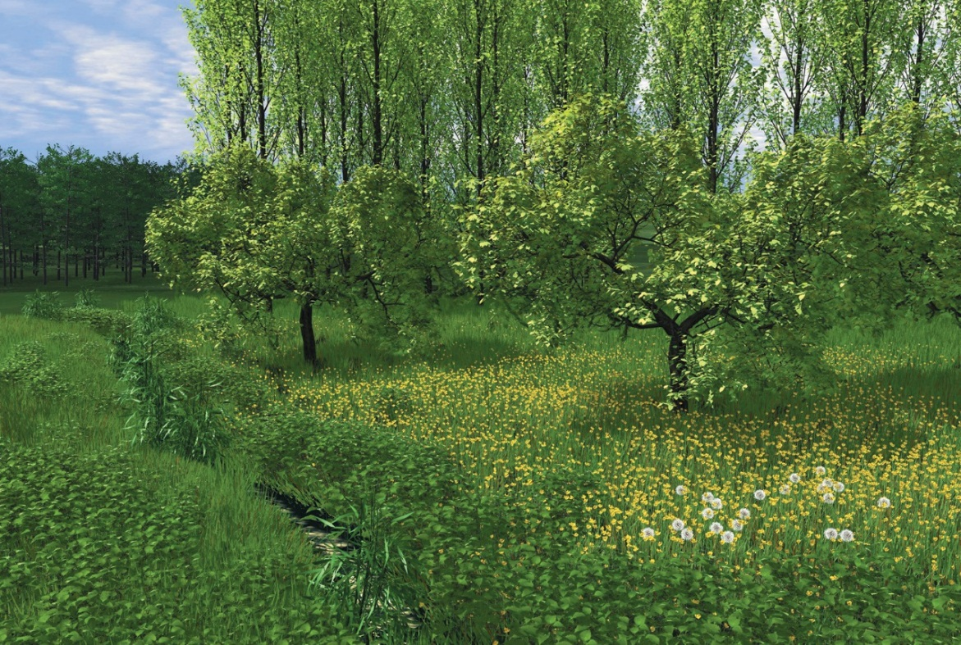
Modeling Complex Objects (1 of 7)
What
graphics
challenges
are inherent
in natural
landscapes?
A natural computer-generated landscape
Reproduced from Oliver Deussen, et. al., “Realistic Modeling and Rendering of Plant Ecosystems.” SIGGRAPH (1998): 275-286. © 1998 AMC, Inc. Reprinted by permission. [http://doi.acm.org/10.1145/280814.280898]

Slide 24

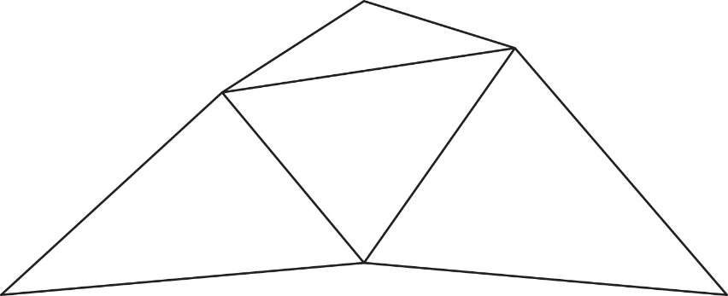
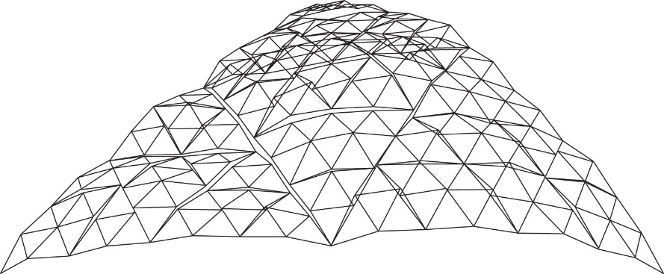
Modeling Complex Objects (2 of 7)
Midpoint sub-division for creating fractal terrains
Figure 14.6 Midpoint subdivision
for creating fractal terrains

Slide 25
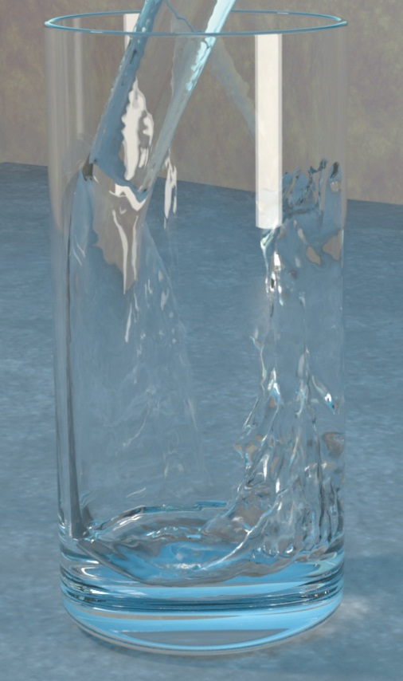
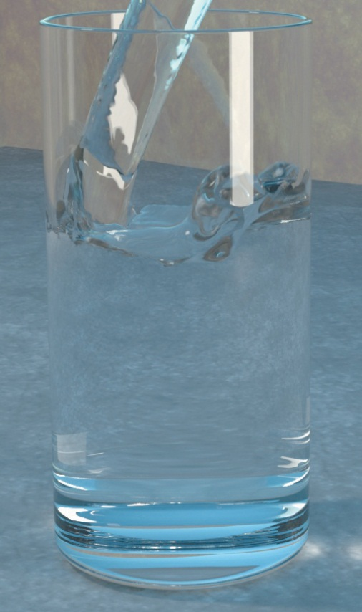
Modeling Complex Objects (3 of 7)
Water pouring into a glass
Reproduced from Douglas Enright, et. al., “Animation and Rendering of complex Water Surfaces.” SIGGRAPH 21 (2002): 275-286. © 2002 AMC, Inc. Reprinted
by permission. [http://doi.acm.org/10.1145/566654.566645]

Slide 26

Modeling Complex Objects (4 of 7)
What
mathematical
technique
is used
in modeling
cloud
formation?
Cellular automata-based clouds
Reproduced from Yoshinori Dobashi, et. al., “A Simple, Efficient Method for Realistic Animation of Clouds.” SIGGRAPH (2000): 19-28. © 2000 AMC, Inc. Reprinted by permission. [http://doi.acm.org/10.1145/344779.344795]

Slide 27


Modeling Complex Objects (5 of 7)
Blowing smoke
Reproduced Ronald Fedkiw, et. al., “ Visual Simulation of Smoke.” SIGGRAPH (2001): 15-22. © 2001 AMC, Inc. Reprinted by permission. [http://doi.acm.org/10.1145/383259.383260]
A campfire
What do smoke and
fire have in common?
Reproduced Duc Quang Nguye, et. al., "Physically Based Modeling and Animation of Fire." SIGGRAPH (2002):
721-728. © 2002 AMC, Inc. Reprinted by permission. [http://doi.acm.org/10.1145/566570.566643]

Slide 28
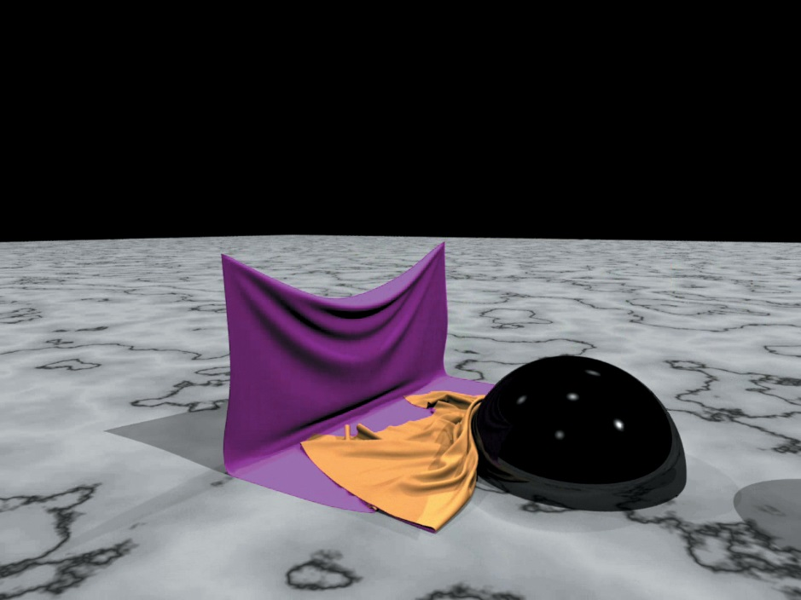
Modeling Complex Objects (6 of 7)
A simulation of cloth showing bending and draping
Courtesy of Robert Bridson. © 2004 Robert Bridson

Slide 29
Modeling Complex Objects (7 of 7)
What is the most difficult object to model?
What is the next step up in complexity?

Slide 30
Computer Gaming
Computer gaming is a computer simulation of a virtual world
Game designers must have knowledge of the following to make people, objects, and environments behave realistically in a virtual world:
Computer graphics
Artificial intelligence
Human-computer interactions and simulation
Software engineering
Computer security
Fundamentals of mathematics
Laws of physics relating to gravity, elasticity, light, and sound

Slide 31
Gameplay
Gameplay: The type of interactions and experiences a player has during the game
Game genres, based on gameplay, include:
Action games
Shooter games
Action-adventure games
Life-simulation games
Role-playing games
Strategy games

Slide 32
Creating the Virtual World (1 of 2)
Game Engine A software system within which games can be created
Following functionality provided by tools of a game engine:
A rendering engine for graphics
A physics engine to provide a collision detection system and dynamics simulation
A sound-generating component

Slide 33
Creating the Virtual World (2 of 2)
Additional functionality resulting from tools of a game engine:
A scripting language apart from the code driving the game
Animation
Artificial intelligence algorithms (e.g., path-finding algorithms)
A scene graph that holds the spatial representation in a graphical sense

Slide 34
Soft Skills (1 of 2)
High-quality game design and development requires effective use of “soft skills”:
Effective collaboration with designers, programmers, and artists on various technical ideas throughout the entire game design and development process
Flexibility and adaptability as the game design constantly evolves and changes throughout the development and production process

Slide 35
Soft Skills (2 of 2)
Willingness to abandon much of the completed design work when the game’s story line, mechanics, art, programming, audio, video, and/or scripting requires significant changes

Slide 36
Game Programming (1 of 5)
After all the design decisions have been finalized, programmers produce the code to create the virtual world of the game
Popular languages include Java, Objective C, C#, and Lua
Some well-established game engineers have created custom languages based on their games (e.g., Epic Games’ UnrealScript for the Unreal Game)

Slide 37
Game Programming (2 of 5)
A variety of application programming interfaces (APIs) and libraries are available to help developers with key programming tasks
The choice of API determines which vocabulary and calling conventions the programmer should employ to use the services
The target game platform determines which service the programmer will use; some libraries permit efficient cross-platform development

Slide 38
Game Programming (3 of 5)
Coding process begins with the creation of “the game loop”
Game loop is responsible for managing the game world, regardless of any input from the user
For example, the game loop might update enemy movement in the game or check for victory/loss conditions
Basically, the game loop manages the simulation

Slide 39
Game Programming (4 of 5)
Large design teams have different programmers focus on different aspects of the game
Thus, you might find yourself working as:
A junior engine programmer, writing and maintaining code for the game loop
A 3D software programmer, designing and implementing the 3D graphics component
A user-interface programmer, working on the APIs in the game engine

Slide 40
Game Programming (5 of 5)
Collaborating effectively is essential to creating a streamlined, “killer” computer game
Collaboration and cooperation will be necessary because, despite beta testing and demoing, invariably bugs may begin to adversely effect the operation of the game
If it is an online game you helped develop, you will be able to perform any fixes without having to interrupt the ongoing action or force the company to order a costly recall of the game

Slide 41
Ethical Issues
Gaming as an Addiction
What addictive characteristics does video gaming share with alcohol and drug addiction and other impulse control disorders?
How are treatment options for video gaming addiction similar and different than treatment for alcohol and drug addiction?
Is video gaming addiction a formal diagnosis?

Slide 42

Who Am I?
I am a
generalist;
I have done
many different
things.
Do you know
for what my
Turing Award
was given?
© Kenichiro Seki/Xinhua Press/Corbis

Slide 43
Do You Know?
What was the first object-oriented language?
What are scientists using to detect tsunamis?
Why were there fewer hurricanes than predicted in 2013?
Where are Voyager 1 and 2 now?
What is haptic technology? Give an example.

